Slide 1
XML FILES & CSS
Simple Files
Collaboration to CSS
DTD Files

Slide 2
Viewing XML Files
Don't expect XML files to be displayed as HTML pages.
The XML document will be displayed with color-coded root and child elements.
A plus (+) or minus sign (-) to the left of the elements can be clicked to expand or collapse the element structure.
To view the raw XML source, select "View Page Source“ from the browser menu.
Why Does XML Display Like This?
Since XML tags are "invented" by the author of the XML document, browsers do not know if a tag like <table> describes an HTML table or a dining table.
Without any information about how to display the data, most browsers will just display the XML document as it is.

Slide 3
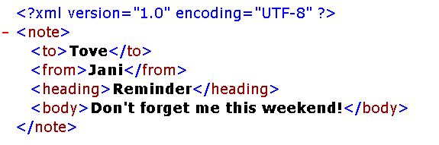

Viewing XML File’s OUTPUT: (Collapse code)
(Expandable code)

Slide 4
Displaying your XML Files with CSS?
<?xml version="1.0" encoding="UTF-8"?>
<?xml-stylesheet type="text/css" href="cd_catalog.css"?>
<CATALOG>
<CD> <TITLE>Empire Burlesque</TITLE> <ARTIST>Bob Dylan</ARTIST> <COUNTRY>USA</COUNTRY> <COMPANY>Columbia</COMPANY> <PRICE>10.90</PRICE> <YEAR>1985</YEAR> </CD>
<CD> <TITLE>Hide your heart</TITLE> <ARTIST>Bonnie Tyler</ARTIST> <COUNTRY>UK</COUNTRY> <COMPANY>CBS Records</COMPANY> <PRICE>9.90</PRICE> <YEAR>1988</YEAR> </CD>
</CATALOG>
An xml file “CDBOOK.xml”

Slide 5
Displaying your XML Files with CSS?
A CSS file “cd_catalog.css”
CATALOG
{ background-color: #00ff44;
width: 100%;
}
CD{
display: block;
margin-bottom: 30pt;
margin-left: 0;
}
TITLE {
color: #FF0000;
font-size: 20pt;
}
ARTIST
{
color: #0000FF;
font-size: 20pt;
}
COUNTRY,PRICE,YEAR,COMPANY
{
display: block;
color: #000000;
margin-left: 20pt;
}

Slide 6
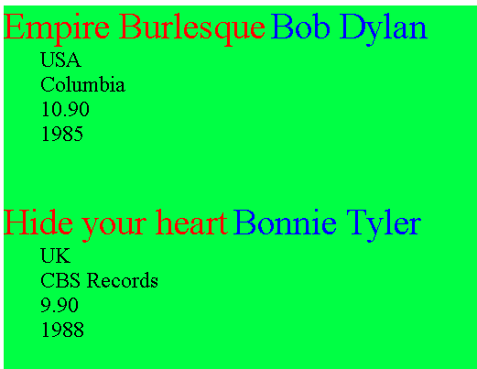
Browser output

Slide 7
XML Document Types
An XML document with correct syntax is called "Well Formed". i.e.
XML document must have a root element, a closing tag, case sensitive, properly nested and values must be quoted.
When to Use a Document Definition?
A document definition is the easiest way to provide a reference to the legal elements and attributes of a document.
A document definition also provides a common reference that many users (developers) can share.
A document definition provides a standardization that makes life easier.

Slide 8
Document Definitions:
There are different types of document definitions that can be used with XML:
The original Document Type Definition (DTD)
The newer, and XML based, XML Schema
Valid XML Documents
<?xml version="1.0" encoding="UTF-8"?>
<!DOCTYPE note SYSTEM "Note.dtd">
<note> <to>Tove</to> <from>Jani</from> <heading>Reminder</heading> <body>Don't forget me this weekend!</body>
</note>
The DOCTYPE declaration, in the example above, is a reference to an external DTD file. The content of the file is shown in the next slide.

Slide 9
XML DTD file “Note.dtd”
The purpose of a DTD is to define the structure of an XML document. It defines the structure with a list of legal elements:
<!DOCTYPE note [ <!ELEMENT note (to,from,heading,body)> <!ELEMENT to (#PCDATA)> <!ELEMENT from (#PCDATA)> <!ELEMENT heading (#PCDATA)> <!ELEMENT body (#PCDATA)> ]>
Notes:
PCDATA means parsed character data.

Slide 10
XML DTD file “Note.dtd”
The DTD above is interpreted like this:
!DOCTYPE note defines that the root element of the document is note
!ELEMENT note defines that the note element contains four elements: "to, from, heading, body"
!ELEMENT to defines the to element to be of type "#PCDATA"
!ELEMENT from defines the from element to be of type "#PCDATA"
!ELEMENT heading defines the heading element to be of type "#PCDATA"
!ELEMENT body defines the body element to be of type "#PCDATA"

